Slide 1

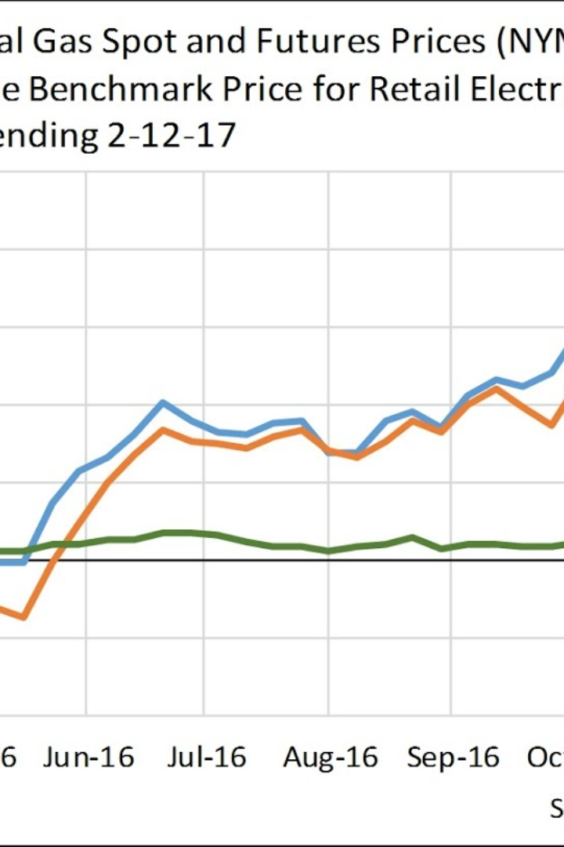


ELECTRICITY PRICE PREDICTION
Explore the importance of predicting electricity prices and its applications in energy trading, infrastructure planning, and consumer pricing. Discover the factors affecting prices and methods used for prediction.
by Priyadharshini Sundarasamy

Slide 2

Importance of Electricity Price Prediction
1
Optimizing Energy Trading
2
Informed Infrastructure Planning
Predicting prices helps traders make informed decisions and mitigate risks in the volatile energy market.
Prediction models assist in planning new power plants and transmission lines based on future pricing scenarios.
3
Sustainable Consumer Pricing
Knowing price trends enables utilities to implement effective demand management strategies and fair pricing for consumers.

Slide 3
Factors Affecting Electricity Prices
Supply and Demand Dynamics
Fuel Prices and Cost of Production
Weather Conditions
Regulatory Policies
Extreme weather events and seasonal variations affect electricity demand and generation capacity.
Government regulations and policies on emissions, renewable energy, and market structures shape price dynamics.
Fluctuations in electricity supply and demand contribute to price volatility in the market.
The cost of fuels used in electricity generation, such as coal and natural gas, significantly impact prices.

Slide 4
Methods of Electricity Price Prediction
1
Historical Data Analysis
Analyze past price patterns to identify trends and conduct statistical analysis for predictive insights.
Time Series Forecasting Models
2
Utilize mathematical models like ARIMA and exponential smoothing to project future price movements.
3
Machine Learning Algorithms
Apply advanced algorithms like neural networks and random forests to analyze vast datasets and make accurate predictions.

Slide 5



Applications of Electricity Price Prediction
Energy Trading and Risk Management
Infrastructure Planning and Investment
Consumer Pricing and Demand Management
Predictions guide trading strategies and risk assessment to maximize profitability.
Enable utilities to optimize pricing and encourage consumers to make energy-efficient choices.
Anticipate future price trends to support effective planning and investment decisions in the energy sector.

Slide 6
Challenges and Limitations
Uncertainty in Data and Market Conditions
Complex and Dynamic Nature of Electricity Markets
Lack of Transparency in Pricing Mechanisms
Data quality and market volatility pose challenges in accurately predicting electricity prices.
The intricate interactions among market participants make price forecasting a complex task.
Opaque pricing structures make it difficult to access accurate and timely pricing information.

Slide 7

Conclusion
Electricity price prediction is a crucial tool for various stakeholders in the energy industry. By understanding the factors influencing prices and utilizing advanced prediction methods, we can make informed decisions to optimize trading, planning, and consumer pricing.

